Slide 1
Cross Examination in theory and in practice Saul Holt KC 8 Petrie Terrace Chambers May 2023

Slide 2
CROSS EXAMINATION IS:
A foundation for final argument, but not the putting of the final argument | Consistent with the case theory and targeted only to the case theory
Organized, structured and controlled by the advocate | Conducted by leading, single issue propositions
Designed to a specific purpose, for example, to accredit or discredit a witness | Not a repetition of evidence in chief
Structured to minimize risk (sometimes called “gate closing”) | Not unnecessarily aggressive or confrontational
Not inquisitorial: don’t normally ask questions you don’t know the answer to | Not a place to ask for explanations

Slide 3
CROSS EXAMINATION IS:
A foundation for final argument, but not the putting of the final argument | Consistent with the case theory and targeted only to the case theory
Organized, structured and controlled by the advocate | Conducted by leading, single issue propositions
Designed to a specific purpose, for example, to accredit or discredit a witness | Not a repetition of evidence in chief
Structured to minimize risk (sometimes called “gate closing”) | Not unnecessarily aggressive or confrontational
Not inquisitorial: don’t normally ask questions you don’t know the answer to | Not a place to ask for explanations

Slide 4
Ultimate Conclusion:
Gable Tostee did not murder Warriena Wright
Conclusion 1: He was defending his property
Support:
Section 277 allows a disorderly person to be removed
The deceased was being disorderly as the recording shows
The defendant used no more than reasonable force to remove her
There is no evidence he choked her
Conclusion 2: she behaved irrationally and broke the chain of causation
Support:
Climbing off a 14 storey balcony was irrational
Closed door between them
Consistent with her irrational behaviour during the night
So irrational that he is not responsible for causing her death
Conclusion 3: His behaviour afterwards was odd but does not make him a murderer
Support:
Called a lawyer, ate pizza, did not call an ambulance and avoided Police
Not possible to predict how it would be “normal” to react
Had a history with the police
Knew how it would look
Doesn’t matter because recording shows he didn’t murder her

Slide 5
Submissions
Final Position
Why
Because
1. Proposition
2. Proposition
3. Proposition
Why/
Because
1. Reason/Fact
2. Reason/Fact
Why/Because
1. Reason/Fact
3. Reason/Fact
2. Reason/Fact
Why/Because
1. Reason/Fact
2. Reason/Fact

Slide 6
Closing Evidence
Final Position
Why
Because
Proposition
Proposition
Proposition
Why/
Because
Reason/Fact
Reason/Fact
Why/Because
Reason/Fact
Reason/Fact
Reason/Fact
Why/Because
Reason/Fact
Reason/Fact

Slide 7
CROSS EXAMINATION IS:
A foundation for final argument, but not the putting of the final argument | Consistent with the case theory and targeted only to the case theory
Organized, structured and controlled by the advocate | Conducted by leading, single issue propositions
Designed to a specific purpose, for example, to accredit or discredit a witness | Not a repetition of evidence in chief
Structured to minimize risk (sometimes called “gate closing”) | Not unnecessarily aggressive or confrontational
Not inquisitorial: don’t normally ask questions you don’t know the answer to | Not a place to ask for explanations

Slide 8
Deciding how and who to XXN
Has the witness hurt my case?
Is the witness important?
Was the witness’s testimony credible?
Did the witness give less than expected?
What are my realistic expectations on cross-examination?
What risks do I need to take?

Slide 9
CROSS EXAMINATION IS:
A foundation for final argument, but not the putting of the final argument | Consistent with the case theory and targeted only to the case theory
Organized, structured and controlled by the advocate | Conducted by leading, single issue propositions
Designed to a specific purpose, for example, to accredit or discredit a witness | Not a repetition of evidence in chief
Structured to minimize risk (sometimes called “gate closing”) | Not unnecessarily aggressive or confrontational
Not inquisitorial: don’t normally ask questions you don’t know the answer to | Not a place to ask for explanations

Slide 10
CROSS EXAMINATION IS:
A foundation for final argument, but not the putting of the final argument | Consistent with the case theory and targeted only to the case theory
Organized, structured and controlled by the advocate | Conducted by leading, single issue propositions
Designed to a specific purpose, for example, to accredit or discredit a witness | Not a repetition of evidence in chief
Structured to minimize risk (sometimes called “gate closing”) | Not unnecessarily aggressive or confrontational
Not inquisitorial: don’t normally ask questions you don’t know the answer to | Not a place to ask for explanations

Slide 11
CROSS EXAMINATION IS:
A foundation for final argument, but not the putting of the final argument | Consistent with the case theory and targeted only to the case theory
Organized, structured and controlled by the advocate | Conducted by leading, single issue propositions
Designed to a specific purpose, for example, to accredit or discredit a witness | Not a repetition of evidence in chief
Structured to minimize risk (sometimes called “gate closing”) | Not unnecessarily aggressive or confrontational
Not inquisitorial: don’t normally ask questions you don’t know the answer to | Not a place to ask for explanations

Slide 12
CROSS EXAMINATION IS:
A foundation for final argument, but not the putting of the final argument | Consistent with the case theory and targeted only to the case theory
Organized, structured and controlled by the advocate | Conducted by leading, single issue propositions
Designed to a specific purpose, for example, to accredit or discredit a witness | Not a repetition of evidence in chief
Structured to minimize risk (sometimes called “gate closing”) | Not unnecessarily aggressive or confrontational
Not inquisitorial: don’t normally ask questions you don’t know the answer to | Not a place to ask for explanations

Slide 13
CROSS EXAMINATION IS:
A foundation for final argument, but not the putting of the final argument | Consistent with the case theory and targeted only to the case theory
Organized, structured and controlled by the advocate | Conducted by leading, single issue propositions
Designed to a specific purpose, for example, to accredit or discredit a witness | Not a repetition of evidence in chief
Structured to minimize risk (sometimes called “gate closing”) | Not unnecessarily aggressive or confrontational
Not inquisitorial: don’t normally ask questions you don’t know the answer to | Not a place to ask for explanations

Slide 14
CROSS EXAMINATION IS:
A foundation for final argument, but not the putting of the final argument | Consistent with the case theory and targeted only to the case theory
Organized, structured and controlled by the advocate | Conducted by leading, single issue propositions
Designed to a specific purpose, for example, to accredit or discredit a witness | Not a repetition of evidence in chief
Structured to minimize risk (sometimes called “gate closing”) | Not unnecessarily aggressive or confrontational
Not inquisitorial: don’t normally ask questions you don’t know the answer to | Not a place to ask for explanations

Slide 15
CROSS EXAMINATION IS:
A foundation for final argument, but not the putting of the final argument | Consistent with the case theory and targeted only to the case theory
Organized, structured and controlled by the advocate | Conducted by leading, single issue propositions
Designed to a specific purpose, for example, to accredit or discredit a witness | Not a repetition of evidence in chief
Structured to minimize risk (sometimes called “gate closing”) | Not unnecessarily aggressive or confrontational
Not inquisitorial: don’t normally ask questions you don’t know the answer to | Not a place to ask for explanations

Slide 16
Proposition last not first
1. Fact
2. Fact
PROPOSITION
3. Fact
4. Fact

Slide 17
Closing Gates

Slide 18
The basics

Slide 19
Single propositions
No tag ons
Control the pace
Conversational and easy

Slide 20
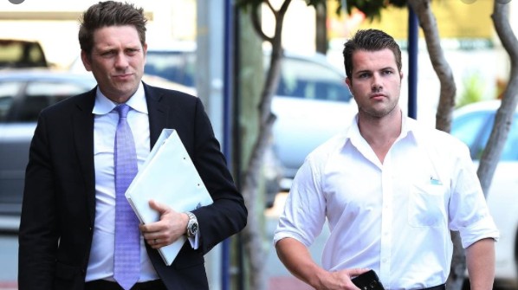

Slide 21
Cross examining for a purpose

Slide 22
Drug deal at the hunting club
Police officer gives evidence that he saw a man matching the description of the accused was outside the hunting club at 7.15pm
He saw him hand a package to a man in a clown costume
Clown was arrested down the road with 1kg of Meth

Slide 23
Police officer’s notes
Approx 5ft 9inches
Blonde shoulder length hair
Male
Wearing a blue suit

Slide 24
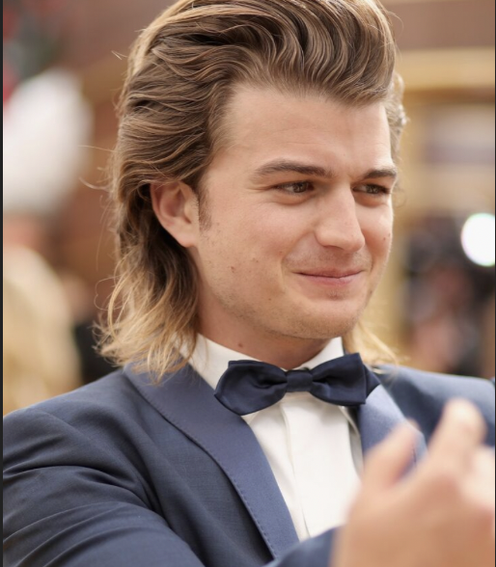
The defendant on the day

Slide 25
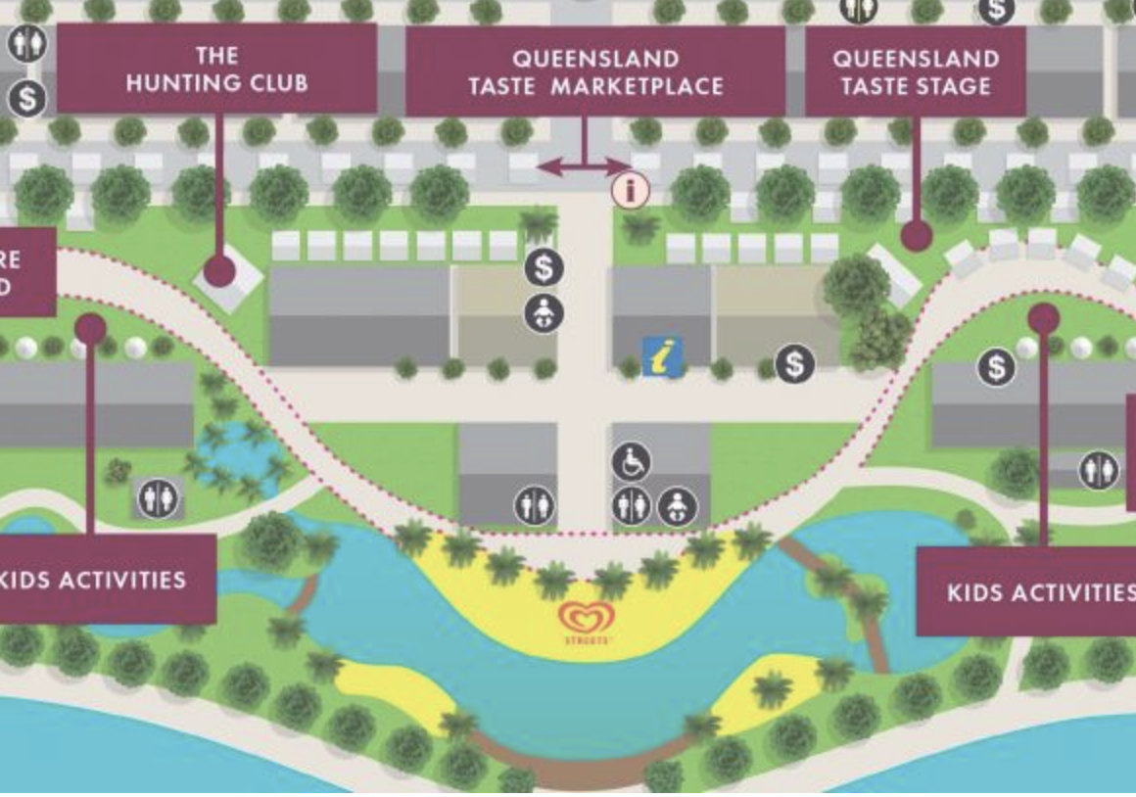

Slide 26
Minimizing risk (AKA Closing the gates) Example 1 – Officer Jamieson

Slide 27
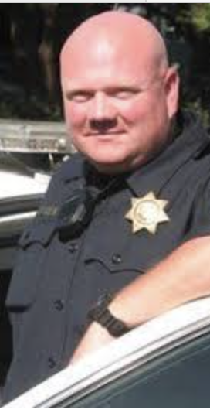
This is Officer Jamieson

Slide 28
Police Officer’s Notes
1232 – see UK male run from vehicle in James St – holden ?? Looks dodgy – check intel
1404 – TCF station – armed robbery in Richards St at lunchtime, blue vehicle seen decamping scene at speed
1753 – spoke to Reynolds HS yep I ran from a car at lunch in the valley– was just going for a run and my mates dropped me off

Slide 29
Officer Jamieson’s Evidence
“I observed the defendant exit a blue motor vehicle which then exited the scene at high speed”
“I later spoke to the defendant who said ”yep that was me who exited that blue vehicle but I was just going for a run”

Slide 30
Minimizing risk (AKA Closing the gates) Example 2 – Lie to the Police

Slide 31
Gary Singh’s interview with the Police
“Q We have reason to believe that Jane Aguilar robbed a servo last week and that she had help?
A Oh ok
Q Where were you yesterday?
A I was at my office next to the servo
Q Do you know Jane Aguilar?
A No I’ve never heard of her … no wait maybe I know the name … actually I think she might be a friend of my brother”

Slide 32
Evidence of Michael Boeman
“I was speaking to Gary the day after the servo was robbed. He mentioned that his friend Jane Aguilar had popped into see him the day before. He said they used to go out at uni”

Slide 33
Evidence in chief of Gary Singh
“I’ve known Jane Aguilar since uni days but I haven’t seen her for ages until the day of the robbery. I just freaked out when I was speaking to the police”

Slide 34
Cross examining at a committal?
To lay a foundation for a no case or a submission to the DPP
To learn new information
To lock a witness into certain answers
To try a line of defence in advance of trial
To see how a witness will be
To have a crack and see what comes out

Slide 35
Some Particular Issues
The rule in Browne v Dunn
Cross examining on prior statements
Listening to the answers
An exercise in psychology

